Slide 1
THE GRANT GROUP LLC.
MARCH 24, 2021
Sepsis Prevention & Early Recognition
JANET A. PHOENIX, MD, MPH, MS
MICHELLE GEORGE, MPH
Notes:
No References listed here

Slide 2
Outline
Sepsis Training Day # 2
Pre-Test
Institute of Medicine Recommendations
Recap of Day One
Best Practice Models for Early Recognition
Best Practice Models for Implementation of a Quality Improvement/Performance Improvement Initiative
Barriers to Implementation
Facilitators
Questions and Answers
Pre-Test Answer Review
Notes:
No References listed here

Slide 3
CDC, Sepsis Alliance® and the Rory Staunton Foundation for Sepsis Prevention Fact Sheet
Insights from IOM Sepsis Workshop
Focus on family and caregiver role in recognition
Covid-19 may teach us things that could improve sepsis diagnosis
Early sepsis diagnosis and intervention can improve patient outcomes.
Quality improvement initiatives can drive behavior change to improve patient care
Notes:
National Academies of Science, Engineering and Medicine. (2020). Achieving Excellence in Sepsis Diagnosis. http://nap.edu/26034. Accessed November 15, 2020.

Slide 4
MARCH 24, 2021
Recap of Day One
J
Notes:
No References listed here

Slide 5
Notes:
Alliance for Aging Research. Sepsis in Older Americans: Saving Lives through Early Recognition. (2018). Retrieved from https://www.youtube.com/watch?v=k1mCpc3xwRM on March 18th, 2021

Slide 6
TIMELINE
SIRS criteria came early and was used for decades.
2014 Society of Critical Care Medicine and European Society of Intensive Care Medicine met
Developed SOFA and qSOFA
qSOFA required no labs.
Notes:
Sloane, P.D., Ward, K., & Weber, D.J., (2018) Can Sepsis Be Detected in the Nursing Home Prior to the Need for Hospital Transfer? JAMDA, 19, 492-496. https://doi.org/10.1016/j.jamda.2018.02.001

Slide 7
TIMELINE CONTINUED…
Minnesota Hospital Association
100/100/100 Screening Tool
Recommended for Long Term Care in 2016
INTERACT published Care Path for Sepsis in 2017
Notes:
Mylotte, J.M. (2020). What is the Role of Nursing Homes in the Surviving Sepsis Campaign? JAMDA 21: 41-45.

Slide 8
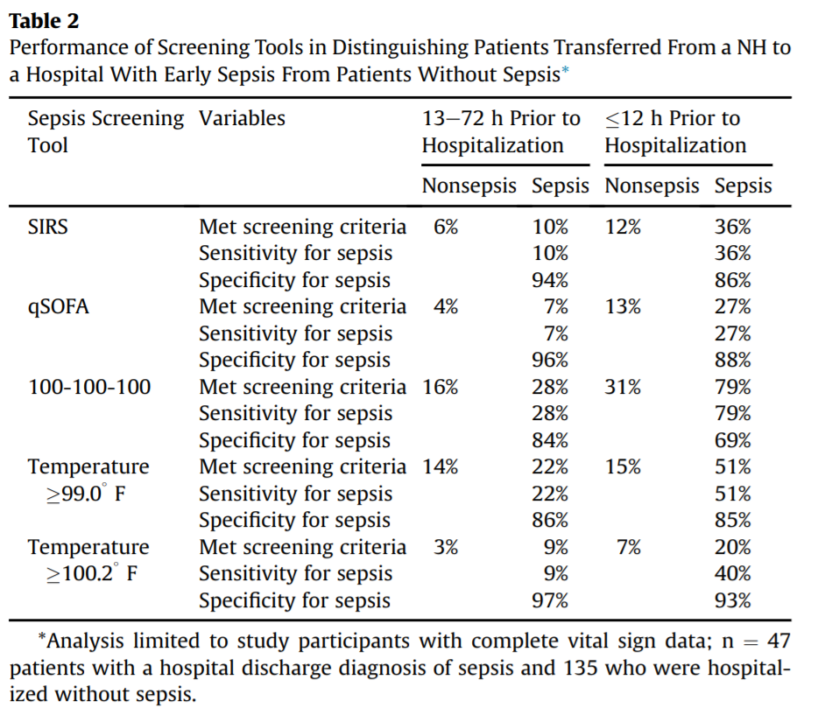
Sloane et. al Comparison of Screening Tools with Hospital Sepsis Diagnosis for 59 Patients Transferred to Acute Care from SNF
Notes:
Sloane, P.D., Ward, K., & Weber, D.J., (2018) Can Sepsis Be Detected in the Nursing Home Prior to the Need for Hospital Transfer? JAMDA, 19, 492-496. https://doi.org/10.1016/j.jamda.2018.02.001

Slide 9
Review of Nursing Home Screening Tool for Use Agreement with Sepsis Diagnosis
Glasgow Coma Scale not used
60% had notation of change in mental status
19% had a visit from a NP or physician in 12 hours prior to hospital transfer
Notes:
Sloane, P.D., Ward, K., & Weber, D.J., (2018) Can Sepsis Be Detected in the Nursing Home Prior to the Need for Hospital Transfer? JAMDA, 19, 492-496. https://doi.org/10.1016/j.jamda.2018.02.001

Slide 10
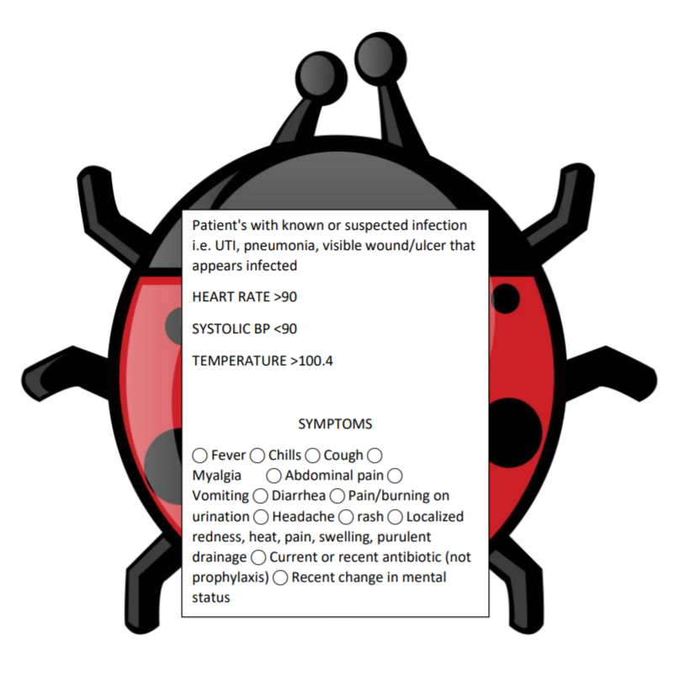
Systemic Inflammatory Response Syndrome (SIRS) CRITERIA (STARFORUM BUG)
Notes:
Nevada Sepsis Coalition. (2018). Nevada Severe Sepsis Screening Tool. Retrieved from https://healthinsight.org/tools-and-resources/send/367-sepsis/1387-severe-sepsis-screening-tool-for-nursing-homes

Slide 11
Systemic Inflammatory Response Syndrome (SIRS)
> 100.4 degrees F
< 96.8 degrees F
> 90 Bpm heart rate
> 20 per minute respiratory rate
> 12,000 WBC count
Notes:
Marik, P. E., & Taeb, A. M. (2017). SIRS, qSOFA and new sepsis definition. Journal of thoracic disease, 9(4), 943–945. https://doi.org/10.21037/jtd.2017.03.125

Slide 12
SIRS Criteria
Moderate sensitivity
Low specificity
Used extensively from 2003-2013
Notes:
Marik, P. E., & Taeb, A. M. (2017). SIRS, qSOFA and new sepsis definition. Journal of thoracic disease, 9(4), 943–945. https://doi.org/10.21037/jtd.2017.03.125

Slide 13
SIRS gave way to SOFA in 2014
Quick
Sequential
Organ
Failure
Assessment
Notes:
Marik, P. E., & Taeb, A. M. (2017). SIRS, qSOFA and new sepsis definition. Journal of thoracic disease, 9(4), 943–945. https://doi.org/10.21037/jtd.2017.03.125

Slide 14
Q SOFA
A sepsis screening tool for use in the non-ICU setting
Developed in 2014 by The Third International Sepsis Consensus Definitions Task Force (a panel of sepsis experts)
3 criteria used to generate a score that identifies patients with suspected infection who are at greater risk for poor outcomes outside of the ICU.
Notes:
Marik, P. E., & Taeb, A. M. (2017). SIRS, qSOFA and new sepsis definition. Journal of thoracic disease, 9(4), 943–945. https://doi.org/10.21037/jtd.2017.03.125

Slide 15
Q SOFA
3 criteria used are as follows:
Altered mental status (Glasgow coma scale <15)
Low blood pressure (SBP≤100 mmHg)
High respiratory rate (≥22 breaths per min)
One point is assigned for each criterion met.
The presence of 2 or more Q SOFA points near the onset of infection is associated with a greater risk of death.
Notes:
Marik, P. E., & Taeb, A. M. (2017). SIRS, qSOFA and new sepsis definition. Journal of thoracic disease, 9(4), 943–945. https://doi.org/10.21037/jtd.2017.03.125

Slide 16
Q SOFA
FOR DEMONSTRATION OF Q SOFA CALCULATION VISIT https://qsofa.org/calc.php and enter the necessary values
Notes:
Marik, P. E., & Taeb, A. M. (2017). SIRS, qSOFA and new sepsis definition. Journal of thoracic disease, 9(4), 943–945. https://doi.org/10.21037/jtd.2017.03.125
Department of Critical Care Medicine, University of Pittsburgh School of Medicine, Pittsburgh, PA; Clinical Research, Investigation, and Systems Modeling of Acute illness (CRISMA) Center. Quick sepsis related organ failure assessment.

Slide 17
Q SOFA LIMITATIONS
Accurately assessing altered mental status can be difficult at the bedside.
Q SOFA uses the Glasgow coma scale to define altered mental status for sepsis, however, the scale was created to measure a person's level of consciousness after a brain injury - and those with suspected sepsis may not necessarily have a brain injury.
Lactate level was not included as a biomarker; this is a well-documented prognostic marker in patients with sepsis.
Notes:
Marik, P. E., & Taeb, A. M. (2017). SIRS, qSOFA and new sepsis definition. Journal of thoracic disease, 9(4), 943–945. https://doi.org/10.21037/jtd.2017.03.125

Slide 18
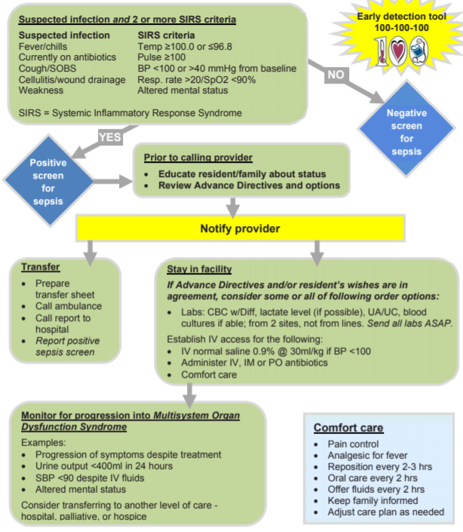
MINNESOTA HOSPITAL ASSOC. TOOL
Notes:
Minnesota Hospital Association. Seeing Sepsis Skilled nursing Facility Sepsis Algorithm for adults. Retrieved from https://www.mnhospitals.org/Portals/0/Documents/ptsafety/SeeingSepsisLTC/1.%20Seeing%20Sepsis%20-%20LTC%20Poster.pdf

Slide 19
Notes:
Minnesota Hospital Association. Seeing Sepsis Skilled nursing Facility Sepsis Algorithm for adults. Retrieved from https://www.mnhospitals.org/Portals/0/Documents/ptsafety/SeeingSepsisLTC/1.%20Seeing%20Sepsis%20-%20LTC%20Poster.pdf

Slide 20
Notes:
Minnesota Hospital Association. Seeing Sepsis Skilled nursing Facility Sepsis Algorithm for adults. Retrieved from https://www.mnhospitals.org/Portals/0/Documents/ptsafety/SeeingSepsisLTC/1.%20Seeing%20Sepsis%20-%20LTC%20Poster.pdf

Slide 21
MINNESOTA HOSPITAL ASSOC. TOOL
100: 100: 100 USES
A screening triage tool for detection of sepsis in long term care settings
Created in response to rising sepsis mortality among older adults.
Initiates intensive surveillance of sepsis by front line medical staff.
Targeted to provide for more structured communication between front line medical staff (CNAs/GNAs/Med-Techs/Medical Assistants) and clinicians
Notes:
Minnesota Hospital Association. Seeing Sepsis Skilled nursing Facility Sepsis Algorithm for adults. Retrieved from https://www.mnhospitals.org/Portals/0/Documents/ptsafety/SeeingSepsisLTC/1.%20Seeing%20Sepsis%20-%20LTC%20Poster.pdf

Slide 22
MINNESOTA HOSPITAL ASSOC. TOOL
100; 100; 100
100 ↑ - is their temperature above 100.
100 ↑ - is their heart rate above 100.
100 ↑ - is their blood pressure below 100.
Does the resident just not look right? Has the resident’s mental status changed? Screen for sepsis and notify the physician immediately.
Notes:
Minnesota Hospital Association. Seeing Sepsis Skilled nursing Facility Sepsis Algorithm for adults. Retrieved from https://www.mnhospitals.org/Portals/0/Documents/ptsafety/SeeingSepsisLTC/1.%20Seeing%20Sepsis%20-%20LTC%20Poster.pdf

Slide 23
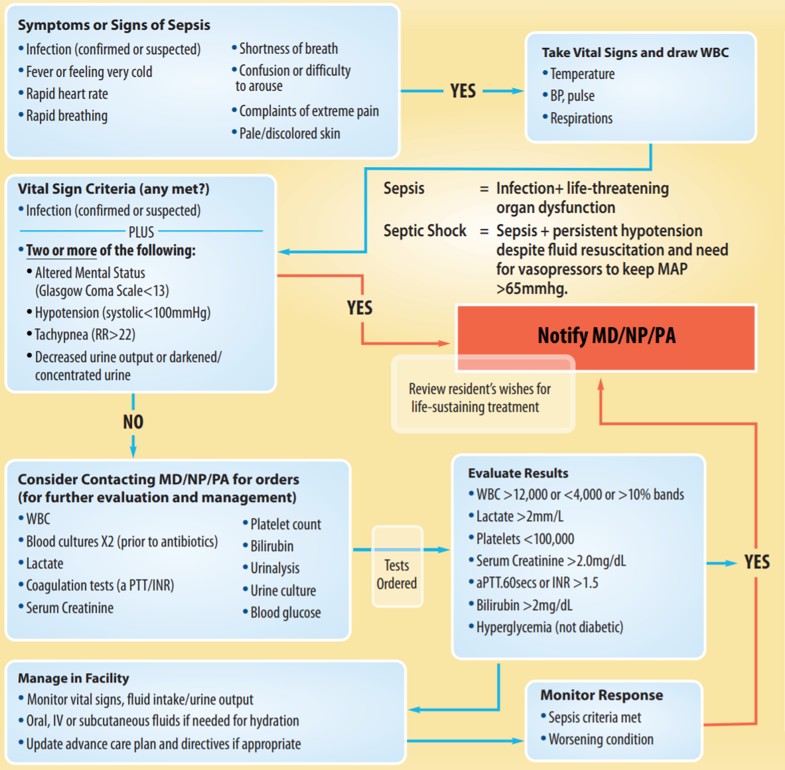
ATLANTIC QUALITY IMPROVEMENT SEPSIS TOOL
Notes:
Quality Improvement Organizations. Centers for Medicare and Medicaid Services, Atlantic Quality Improvement Network. Skilled Nursing Facility Care Pathway Symptoms of Sepsis and Septic Shock https://atlanticquality.org/download/AQIN_Nursing_Facility_Sepsis_Care_Pathway.pdf

Slide 24
ATLANTIC QUALITY IMPROVEMENT SEPSIS TOOL: USES
A screening tool for early recognition of Sepsis in the NH setting
Incorporates Q SOFA and 1 hour bundle of care for sepsis.
Includes screening for sepsis AND septic shock.
Takes into consideration the resident’s wishes for treatment – which is something other screening tools do not mention.
Notes:
Quality Improvement Organizations. Centers for Medicare and Medicaid Services, Atlantic Quality Improvement Network. Skilled Nursing Facility Care Pathway Symptoms of Sepsis and Septic Shock https://atlanticquality.org/download/AQIN_Nursing_Facility_Sepsis_Care_Pathway.pdf

Slide 25
ATLANTIC QUALITY IMPROVEMENT SEPSIS TOOL: LIMITATIONS
Successful management and treatment for sepsis in the NH setting is heavily reliant on early detection and rapid response.
Reliance on necessary labs places burden on NH to ensure that lab used has a fast turnaround time – this may likely be out of the NH’s control.
This tool encourages management of sepsis and septic shock in the facility – however, it should also include the need to transfer to the hospital setting for specialized care if necessary.
Notes:
Quality Improvement Organizations. Centers for Medicare and Medicaid Services, Atlantic Quality Improvement Network. Skilled Nursing Facility Care Pathway Symptoms of Sepsis and Septic Shock https://atlanticquality.org/download/AQIN_Nursing_Facility_Sepsis_Care_Pathway.pdf

Slide 26
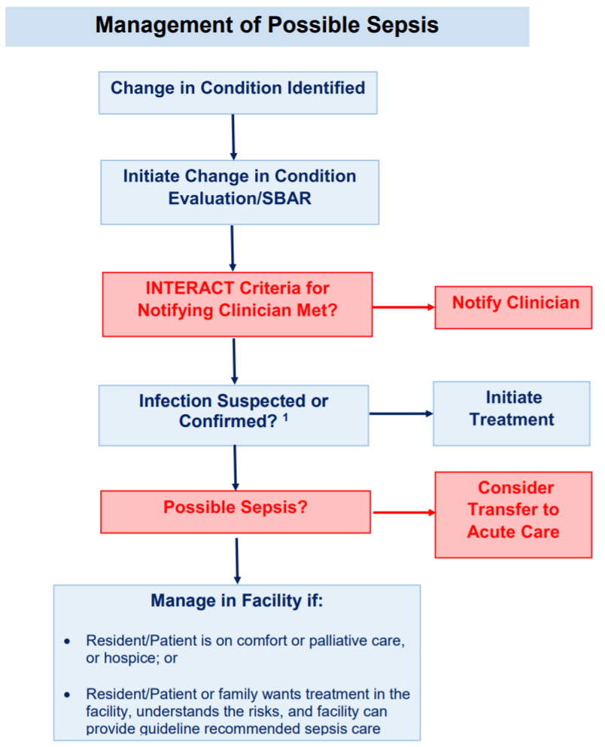
INTERACT TOOL
INTERACT focuses on reducing hospitalization of residents and begins with recognition of a change in status of a resident and provides a method to evaluate this change, for which there are many causes including infection.
Notes:
INTERACT. Retrieved from https://pathway-interact.com/wp-content/uploads/2017/11/INTERACT-Guidance-on-Possible-Sepsis-November-8-2017.pdf

Slide 27
INTERACT TOOL
The INTERACT program includes more than a dozen separate tools.
Some are designed to facilitate early identification of changes in condition while others are designed to improve communication between NH staff, medical providers, and other facilities.
Some tools address implementation of advance directives, thereby reducing the use of acute hospital care when it is clearly not necessary (such as if the resident does not wish to be transferred to a hospital, and when the NH has capacity to handle sepsis)
“Interventions to Reduce Acute Care Transfers” – INTERACT, is a quality improvement program that focuses on the management of acute changes in condition among residents in a skilled nursing facility, and other long-term care settings.
Notes:
INTERACT. https://pathway-interact.com/wp-content/uploads/2017/11/INTERACT-Guidance-on-Possible-Sepsis-November-8-2017.pdf

Slide 28
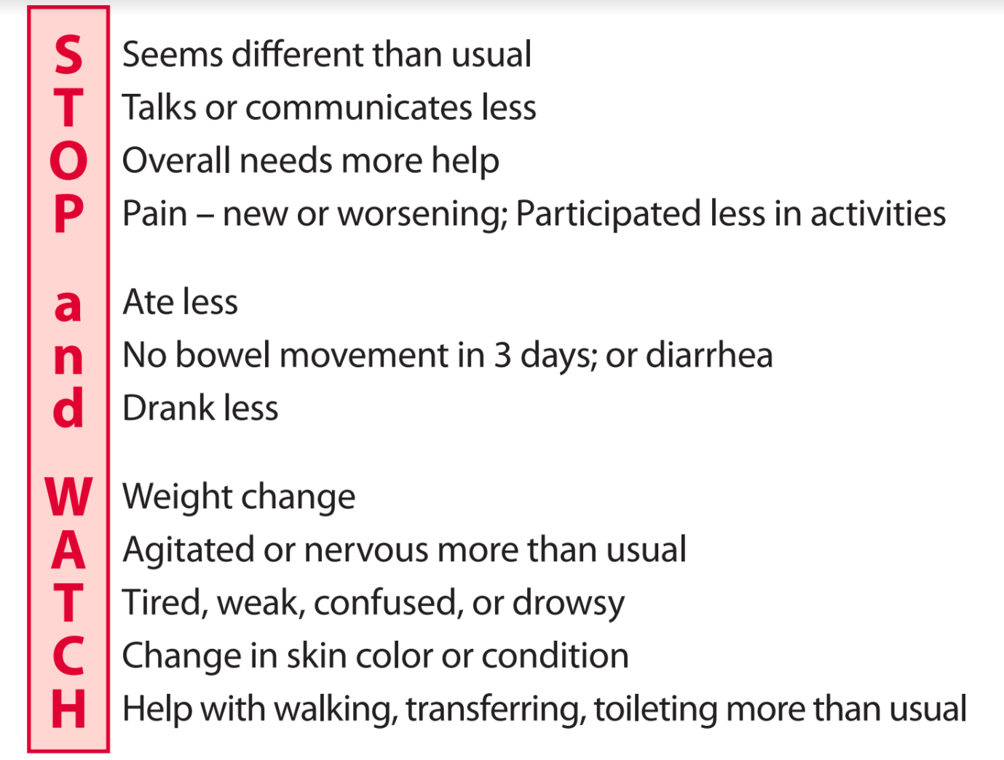
STOP AND WATCH
Notes:
INTERACT. STOP AND WATCH. Retrieved from https://pathway-interact.com/wp-content/uploads/2018/09/INTERACT-Stop-and-Watch-v4_0-June2018_June-2018.pdf

Slide 29
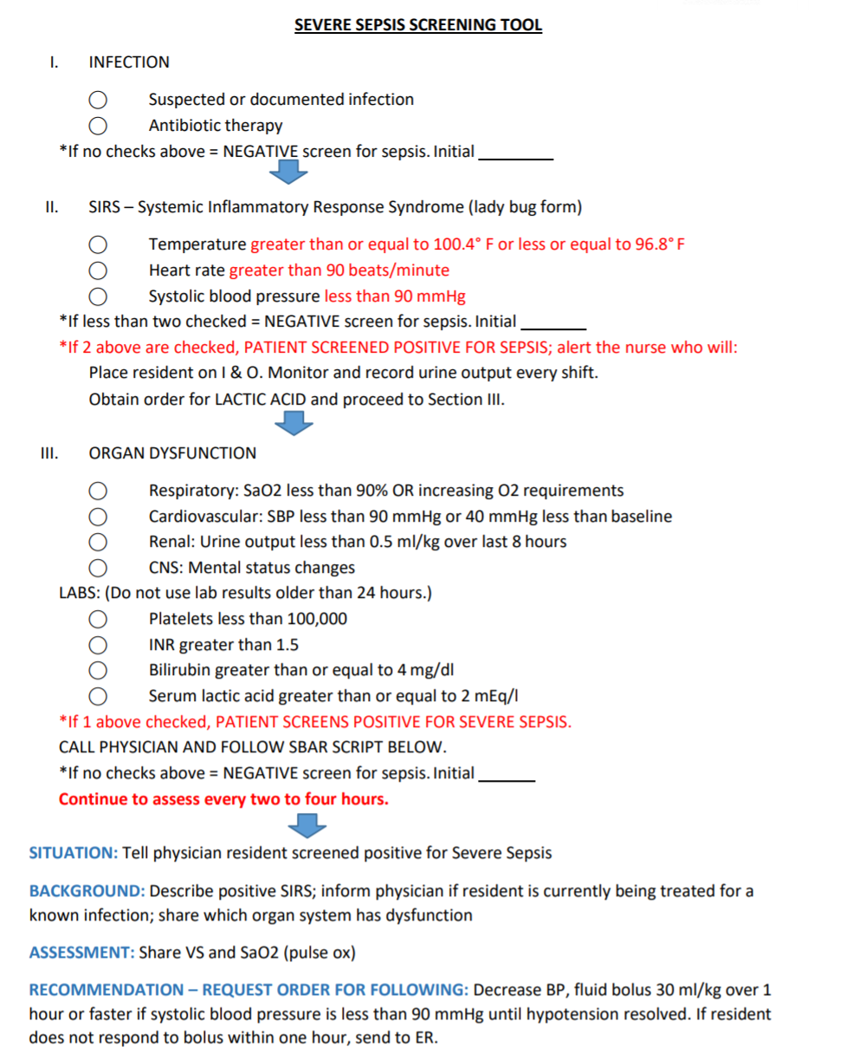
SEVERE SEPSIS
SCREENING TOOL
Notes:
Nevada Severe Sepsis Screening Nevada Sepsis Coalition. (2018). Nevada Severe Sepsis Screening Tool. Retrieved from https://healthinsight.org/tools-and-resources/send/367-sepsis/1387-severe-sepsis-screening-tool-for-nursing-homes
, Nevada Sepsis Coalition

Slide 30
Notes:
Nevada Sepsis Coalition. (2018). Nevada Severe Sepsis Screening Tool. Retrieved from https://healthinsight.org/tools-and-resources/send/367-sepsis/1387-severe-sepsis-screening-tool-for-nursing-homes

Slide 31
Notes:
Nevada Sepsis Coalition. (2018). Nevada Severe Sepsis Screening Tool. Retrieved from https://healthinsight.org/tools-and-resources/send/367-sepsis/1387-severe-sepsis-screening-tool-for-nursing-homes

Slide 32
Notes:
Nevada Sepsis Coalition. (2018). Nevada Severe Sepsis Screening Tool. Retrieved from https://healthinsight.org/tools-and-resources/send/367-sepsis/1387-severe-sepsis-screening-tool-for-nursing-homes

Slide 33
Notes:
Nevada Sepsis Coalition. (2018). Nevada Severe Sepsis Screening Tool. Retrieved from https://healthinsight.org/tools-and-resources/send/367-sepsis/1387-severe-sepsis-screening-tool-for-nursing-homes

Slide 34
Notes:
Nevada Sepsis Coalition. (2018). Nevada Severe Sepsis Screening Tool. Retrieved from https://healthinsight.org/tools-and-resources/send/367-sepsis/1387-severe-sepsis-screening-tool-for-nursing-homes

Slide 35
MEASURING VITAL SIGNS
Temperature
Pulse
Respiratory Rate
Blood Pressure
Oxygen Saturation

Slide 36
CDC, Sepsis Alliance® and the Rory Staunton Foundation for Sepsis Prevention Fact Sheet
Tool Comparison Chart
Tool | Temp Elevation | Temp Depression | BP Hypotension | BP Change | HR | O2 Sat | Resp Rate | Mental Status | White Blood Cell
SIRS | >100.4F | <96.8F | <100 or >40 mmHg |  | >90 bpm |  | 20 or Pco2 <32 |  | >12,000 or < 4,000 or 10% bands
qSOFA | Biomarker not assessed | Biomarker not assessed | <100 mmHg |  |  |  |  | Glasgow coma scale <15
Minn | >100 | <96.8 | <100 mmHg |  | >100 bpm |  | 20 or Pco2 <32 |  | >12,000 or <4,000 or 10
Atlantic | N/A | N/A |  |  |  |  |  |  | >12,000 or < 4,000 or 10% bands
INTERACT | >100.5 |  | <90 or greater than 200 systolic |  | >100 or <50 bpm | <90% | > 28 or Pco2 < 10 |  | >14,000 or neutrophils > 90%
Notes:
Notes:
paC02 partial pressure of carbon dioxide (PaCO2) is one of several measures calculated by an arterial blood gases (ABG) test often performed on people with lung diseases, neuromuscular diseases, and other illnesses. PaCO2 specifically evaluates carbon dioxide (CO2) levels in the blood.
Glasgow Coma Scale is used to evaluate mental status as part of the qSOFA.
Other biomarkers include urine, blood sugar, organ failure, MI or arrythmia

Slide 37
DETERMINING IF THERE IS AN INFECTION
Assessing Symptoms
Identifying a System that Might be Infected.

Slide 38
DOCUMENTING CHANGE IN SYMPTOMS ASSOCIATED WITH A SYSTEM
Use of Assessment Checklist
SBAR to report results of Assessment.

Slide 39
INFORMING CARE MANAGERS ABOUT THE RESULTS OF ASSESSMENT
CNAs need clear guidance about when to report.
Care managers need to take those reports seriously and to act upon them according to established protocols.
Feedback to CNAs and others who report about the disposition of the findings and why.

Slide 40
Sepsis Training Day 2
MARCH , 2021
SBAR

Slide 41
AHRQ: SBAR Tool Design
S – Situation: A concise statement of the problem (what is going on now).
B – Background: Pertinent and brief information related to the situation (what has happened).
A – Assessment: Analysis and consideration of options (what you found/think is going on).
R – Request: Ask for/recommend action (what you want done).
Nursing Home Antimicrobial Stewardship Guide
Determine Whether To Treat
Notes:
AHRQ Nursing Home Antimicrobial Stewardship Guide Toolkit 3. Minimum Criteria for Common Infections Toolkit. Retrieved from https://www.ahrq.gov/nhguide/toolkits/determine-whether-to-treat/toolkit3-minimum-criteria.html#:~:text=The%20Minimum%20Criteria%20for%20Common%20Infections%20toolkit%20(%E2%80%9CMinimum%20Criteria%20toolkit,3)%20skin%20and%20soft%20tissue. (Accessed March 14, 2021).

Slide 42
Notes:
Nevada Sepsis Coalition. (2018). Nevada Severe Sepsis Screening Tool. Retrieved from https://healthinsight.org/tools-and-resources/send/367-sepsis/1387-severe-sepsis-screening-tool-for-nursing-homes. (Accessed March 14, 2021).

Slide 43
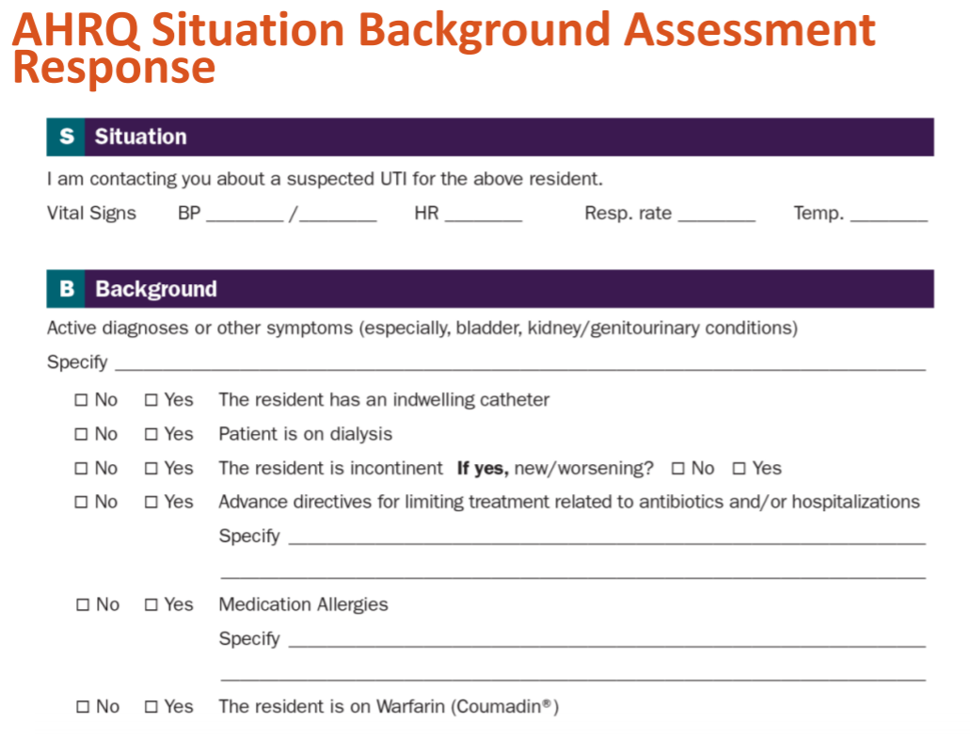
SBAR
Notes:
Agency for Healthcare Research and Quality. AHRQ Situation Background Assessment Response. http://www.ahrq.gov/sites/default/files/wysiwyg/nhguide/4 TK1 T1-SBAR UTI Final.pdf.

Slide 44
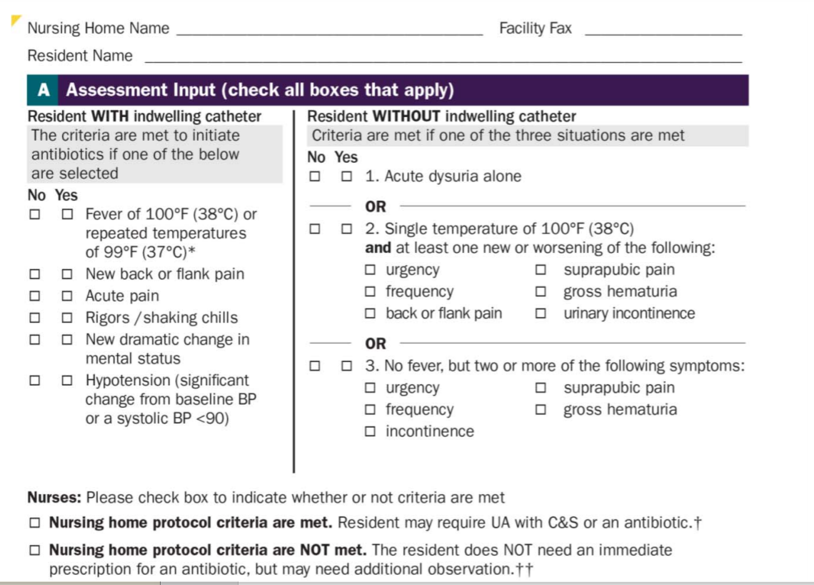
SBAR
Notes:
Agency for Healthcare Research and Quality. AHRQ Situation Background Assessment Response. http://www.ahrq.gov/sites/default/files/wysiwyg/nhguide/4 TK1 T1-SBAR UTI Final.pdf.

Slide 45
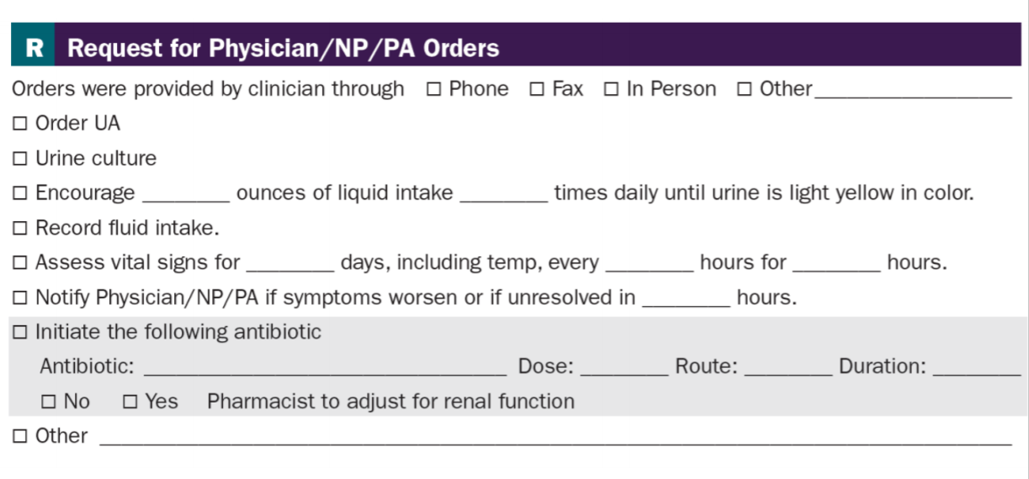
SBAR
Notes:
Agency for Healthcare Research and Quality. AHRQ Situation Background Assessment Response. http://www.ahrq.gov/sites/default/files/wysiwyg/nhguide/4 TK1 T1-SBAR UTI Final.pdf.

Slide 46
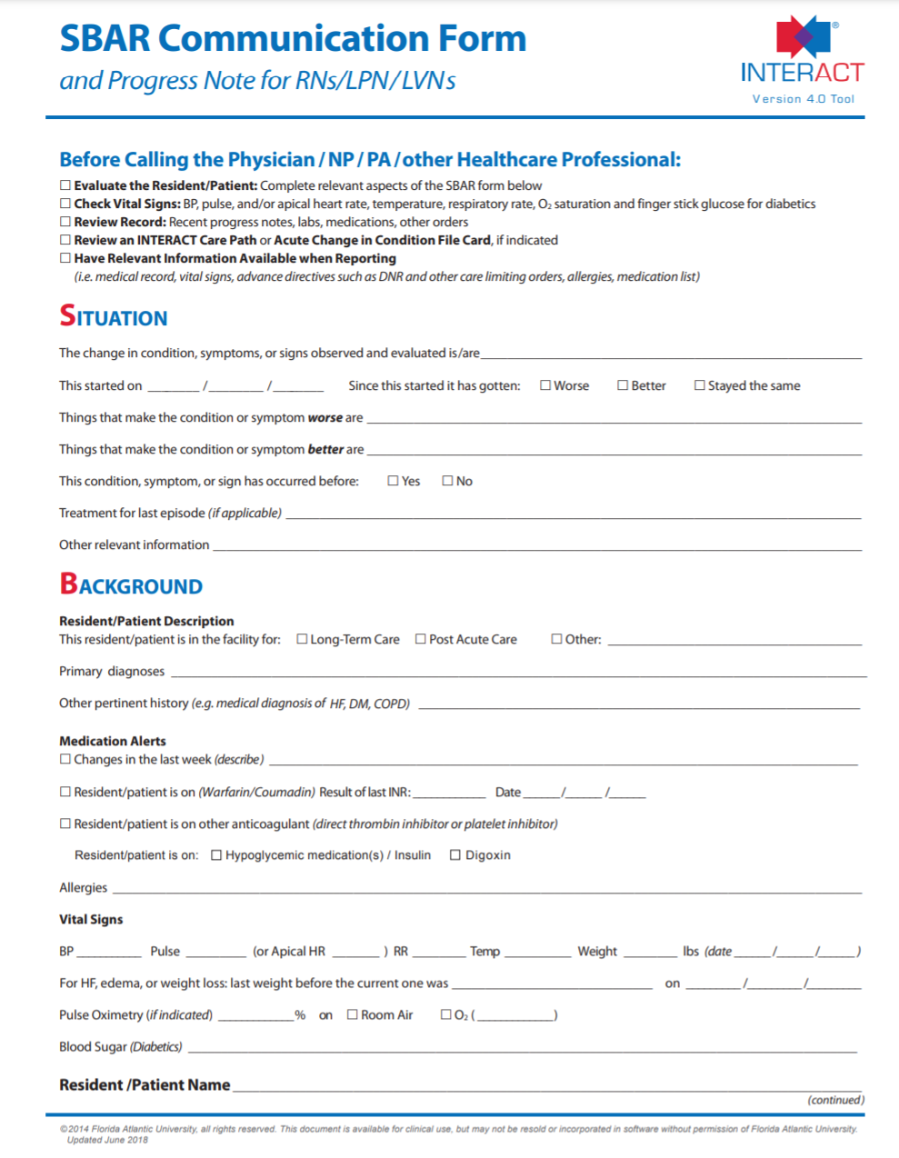
Notes:
INTERACT. (2018). SBAR Communication Form. Retrieved from https://pathway-interact.com/wp-content/uploads/2018/09/INTERACT-V4-SBAR_Communication_Form-Dec_June-2018.pdf

Slide 47
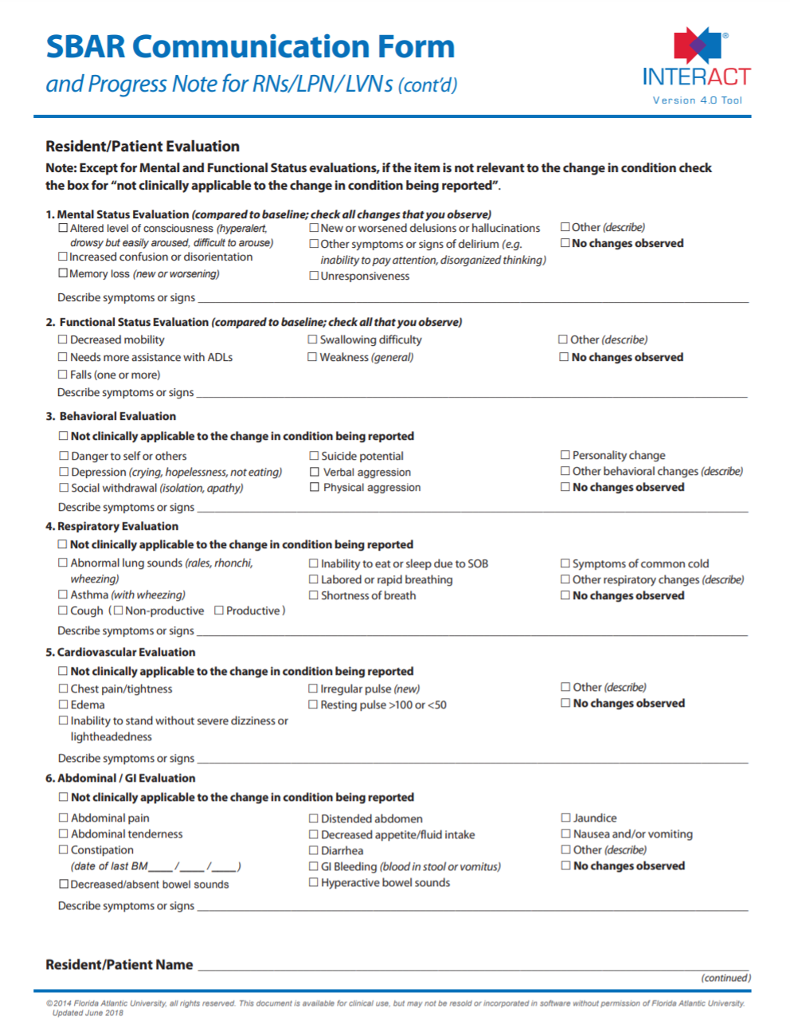
Notes:
INTERACT. (2018). SBAR Communication Form. Retrieved from https://pathway-interact.com/wp-content/uploads/2018/09/INTERACT-V4-SBAR_Communication_Form-Dec_June-2018.pdf

Slide 48
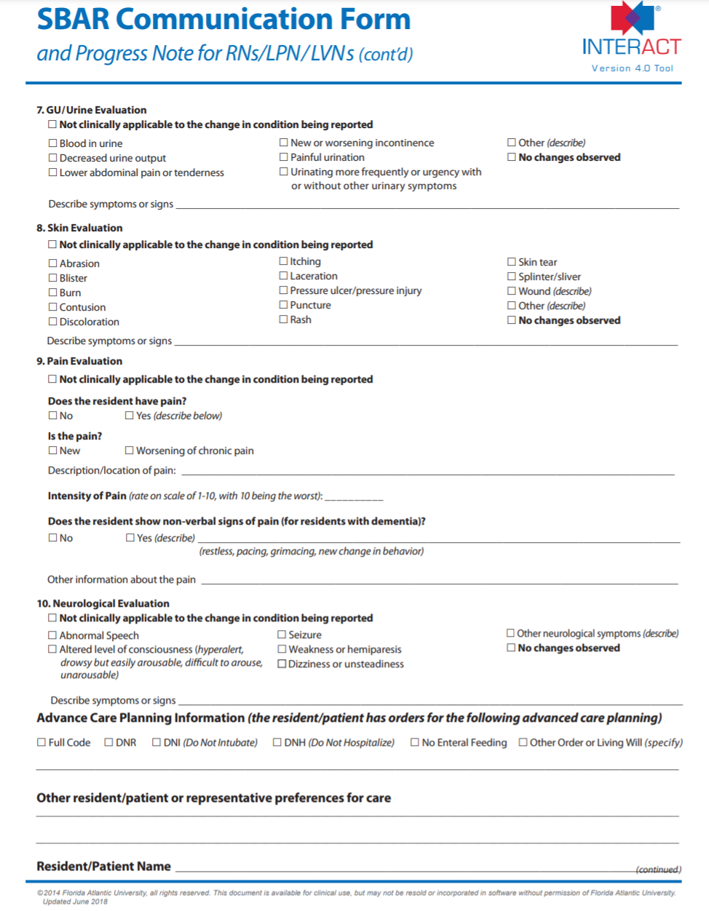
Notes:
INTERACT. (2018). SBAR Communication Form. Retrieved from https://pathway-interact.com/wp-content/uploads/2018/09/INTERACT-V4-SBAR_Communication_Form-Dec_June-2018.pdf

Slide 49
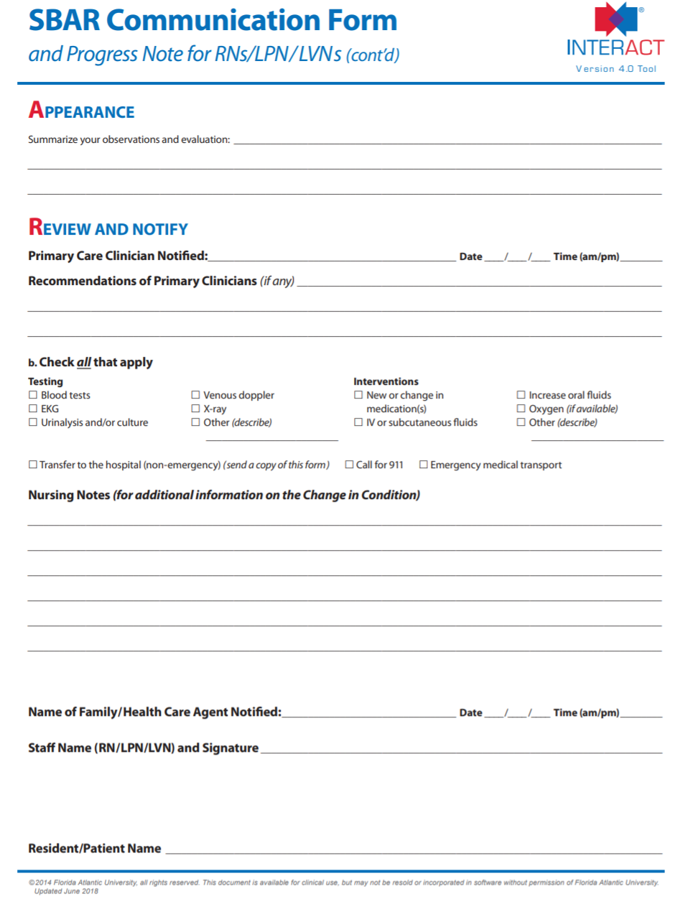
Notes:
INTERACT. (2018). SBAR Communication Form. Retrieved from https://pathway-interact.com/wp-content/uploads/2018/09/INTERACT-V4-SBAR_Communication_Form-Dec_June-2018.pdf

Slide 50
Sepsis Training Day 1
MARCH 17, 2021
If Transfer to an Acute Care Facility is needed
Notes:
No Referenced Content on this Slide

Slide 51
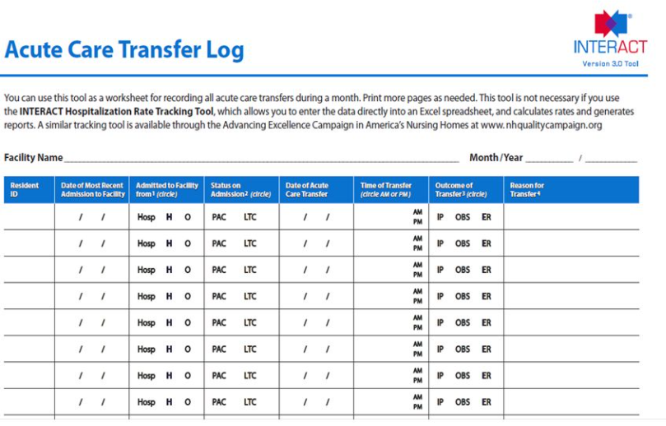
ACUTE CARE TRANSFER
Notes:
Atlantic Quality Improvement Network. (2016). Interact Implementation Learning in Action Collaborative Webinar 4: SBAR. Retrieved from https://atlanticquality.org/download/INTERACT_webinar_4SBAR_final.pdf

Slide 52
Considerations for Transferring a Resident to Acute Care
Determine if patient record indicates that acute care is part of the treatment plan
Determine if there is a DNR on record
Discuss with nursing/medical staff
Notify family members
Notes:
Jump, R.L., Levy, S.M. & Saltsman, W.S. (2019). Post Acute and Long-Term Care Settings as First Responders for the Surviving Sepsis Campaign. JAMDA 20: 285-278.

Slide 53
Considerations for Transferring a Resident to Acute Care
Determine if patient record indicates that acute care is part of the treatment plan
Determine if there is a DNR on record
Discuss with nursing/medical staff
Notify family members
Notes:
Jump, R.L., Levy, S.M. & Saltsman, W.S. (2019). Post Acute and Long-Term Care Settings as First Responders for the Surviving Sepsis Campaign. JAMDA 20: 285-278.

Slide 54
When Considering Transferring a Resident to Acute Care
Make sure a complete record of symptoms, treatment, response to treatment by resident accompanies them to acute care.
Make sure all laboratory results, whether positive or negative are sent to acute care facility preferably through a shared EMR but if not by fax or email.
Make sure acute facility has contact information for the lab so they can discuss results if needed.
Provide contact information for POC at LTC so that acute care staff can contact if they have questions about the transferred patient.
Notes:
Jump, R.L., Levy, S.M. & Saltsman, W.S. (2019). Post Acute and Long-Term Care Settings as First Responders for the Surviving Sepsis Campaign. JAMDA 20: 285-278.

Slide 55
Day One Case Study
The time is 0900 pm. Deborah is a 73-year-old female who has chief complaints of weakness, dizziness, fever, and chills. She had great difficulty standing this afternoon when she tried to go to dinner. It required two staff members to assist her. She is a full code. Her medical history includes heart failure and hypertension. She is a one pack per day smoker. She has lived at the nursing facility for two years since her husband died. Her current weight is 230 pounds. She has no known drug allergies. She has had limited oral intake over last two days due to nausea and decreased appetite. Her skin is pale and moist. Respirations are labored. No family has yet been notified of her condition.
Notes:
Jump, R.L., Levy, S.M. & Saltsman, W.S. (2019). Post Acute and Long-Term Care Settings as First Responders for the Surviving Sepsis Campaign. JAMDA 20: 285-278.

Slide 56
Resident Assessed for Infection and Organ Function
Labs were Ordered with instructions to rush results
Lactate
Blood cultures
UA/UC,
Electrolytes
BUN
Creatinine
PT/INR

Slide 57
Sepsis Bundle Orders
Standing orders were present in the Electronic Health Record
30 mL/kg crystalloid bolus
230 pounds (104 kg) x 30 mL/kg = 3136mL for bolus (3 L of fluid)
Started on broad spectrum antibiotics
Vital signs at least every 15 minutes

Slide 58
Resident Reassessed
Vital signs following fluid bolus:
Blood pressure: 78/46 (Initial Value 84/52)
Pulse: 150 (Initial Value 145)
Temp: unchanged
Oxygen saturation: 88% on 2L
Respirations: 20 – shallow (initial value 22)
Mental State: Remains confused: answers questions inappropriately

Slide 59
Laboratory Values
Labs are in
Lactate: 4.2
WBC: 2.0
Hemoglobin: 9.2
Creatinine: 2.4
INR: 2.1

Slide 60
Sepsis Training Day 2
MARCH , 2021
Best Practices for Initiation of Quality Improvement/ Performance Improvement Initiative on Sepsis
Notes:
No Referenced Content on this slide

Slide 61
ROLE OF THE ELECTRONIC HEALTH RECORD
Prompts in Electronic Health Record that alert for additional monitoring.
Prompts in Electronic Health Record for order sets.
Prompts for high-risk patients for sepsis.
Ability to auto populate vital signs and labs to trigger alerts for clinical staff.
Notes:
Kurczewski L, Sweet M, McKnight R, Halbritter K. Reduction in time to first action as a result of electronic alerts for early sepsis recognition. Crit Care Nurs Q. 2015 Apr-Jun;38(2):182-7. doi: 10.1097/CNQ.0000000000000060. PMID: 25741959.

Slide 62
Use of the Electronic Health Record can support sepsis Decision Making
An electronic alerting system was shown to reduce the time to initiation of therapy for sepsis.
High risk patients were identified and advanced practice nurses and attending physicians were notified when certain criteria were met.
The alert required some action be taken in response to cancel the alert.
The group of septic and septic shock patients prior to implementation of the alert had a mean of 3.5 hours longer time to treatment initiation when compared with patient post-implementation.
Notes:
Kurczewski L, Sweet M, McKnight R, Halbritter K. Reduction in time to first action as a result of electronic alerts for early sepsis recognition. Crit Care Nurs Q. 2015 Apr-Jun;38(2):182-7. doi: 10.1097/CNQ.0000000000000060. PMID: 25741959.

Slide 63
Notification Algorithm for Electronic Health Alerts
Web-based/EHR predictive algorithms that elicit specific data such as but not limited to vital signs (BP, Temp, HR, RR, and SpO2) lab values, nurses notes, and event reports.
EHR serves as a data collection tool and repository for predicting risk of sepsis for patients. A system that provides a data collection tool that allows for continuous analysis and surveillance could be most beneficial.
System must be able to identify SIRS criteria and offer clinical decision support (CDS) to healthcare professionals (such as EPIC system developed collaboratively with UCSF or Cerner implementation at Intermountain Healthcare).
Notes:
Kurczewski L, Sweet M, McKnight R, Halbritter K. Reduction in time to first action as a result of electronic alerts for early sepsis recognition. Crit Care Nurs Q. 2015 Apr-Jun;38(2):182-7. doi: 10.1097/CNQ.0000000000000060. PMID: 25741959.

Slide 64
Definition of Sepsis Intervention
Fluid Bolus
Administration of Broad-Spectrum Antibiotics
Collection of Blood Cultures
Collection of a Lactic Acid level
Notes:
Kurczewski L, Sweet M, McKnight R, Halbritter K. Reduction in time to first action as a result of electronic alerts for early sepsis recognition. Crit Care Nurs Q. 2015 Apr-Jun;38(2):182-7. doi: 10.1097/CNQ.0000000000000060. PMID: 25741959.

Slide 65
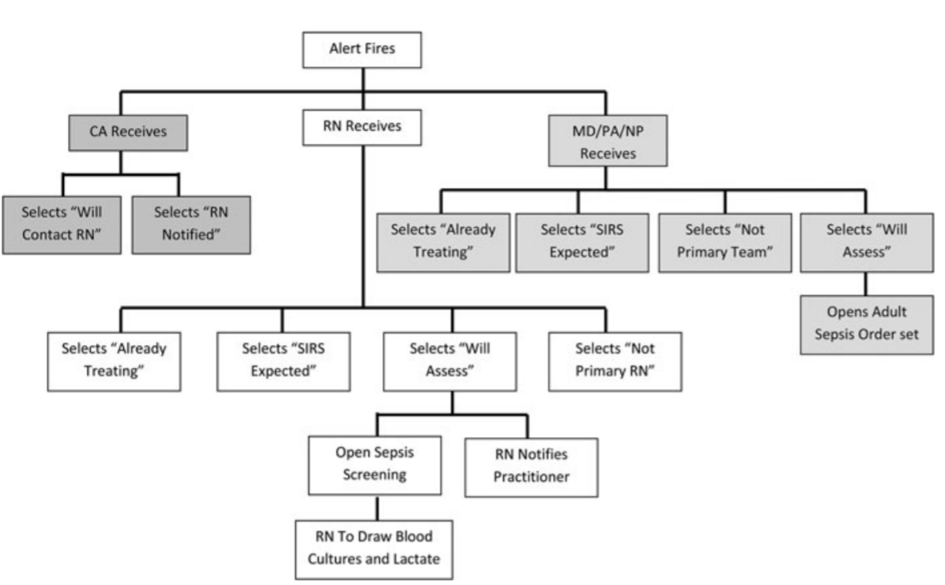
https://journals.lww.com/ccnq/Abstract/2015/04000/Reduction_in_Time_to_First_Action_as_a_Result_of.9.aspx
Electronic Alerts for
Sepsis Recognition
Notes:
Kurczewski L, Sweet M, McKnight R, Halbritter K. Reduction in time to first action as a result of electronic alerts for early sepsis recognition. Crit Care Nurs Q. 2015 Apr-Jun;38(2):182-7. doi: 10.1097/CNQ.0000000000000060. PMID: 25741959.

Slide 66
Simulation as a Tool for Certified Nursing Assistant and Provider Training
Simulation using STOP AND WATCH and SBAR
Two step training focusing initially on STOP AND WATCH to recognize sepsis symptoms early.
Second training focusing on SBAR to alert clinical supervisors about the septic patient’s condition.
Notes:
Mihaljevic SE, Howard VM. Incorporating Interprofessional Evidenced-Based Sepsis Simulation Education for Certified Nursing Assistants (CNAs) and Licensed Care Providers Within Long-term Care Settings for Process and Quality Improvement. Crit Care Nurs Q. 2016 Jan-Mar;39(1):24-33. doi: 10.1097/CNQ.0000000000000092. PMID: 26633155.

Slide 67
Houston Medical Center Nurse Based Early Recognition and Response Program
Developed by Houston Medical Center to equip bedside nurses with an easier to use tool for sepsis screening.
Earlier program failed because bedside nurses found initial tool too cumbersome to use
Adapted a tool that used SIRS criteria based on commonly collected data. Heart rate, respiratory rate, temperature, white blood cell count.
Used an ordinal scale based on deviations from normal (0 to 4)
Combined with a yes/no score for acute mental deterioration
Notes:
Jones, S. L., Ashton, C. M., Kiehne, L., Gigliotti, E., Bell-Gordon, C., Disbot, M., Masud, F., Shirkey, B. A., & Wray, N. P. (2015). Reductions in Sepsis Mortality and Costs After Design and Implementation of a Nurse-Based Early Recognition and Response Program. Joint Commission journal on quality and patient safety, 41(11), 483–491. https://doi.org/10.1016/s1553-7250(15)41063-3

Slide 68
Nurse Based Early Recognition and Response
A score greater than 4 triggers a review by a second responder
Positive predictive value was 80.2%
Negative predictive value 99.5%
Notes:
Jones, S. L., Ashton, C. M., Kiehne, L., Gigliotti, E., Bell-Gordon, C., Disbot, M., Masud, F., Shirkey, B. A., & Wray, N. P. (2015). Reductions in Sepsis Mortality and Costs After Design and Implementation of a Nurse-Based Early Recognition and Response Program. Joint Commission journal on quality and patient safety, 41(11), 483–491. https://doi.org/10.1016/s1553-7250(15)41063-3

Slide 69
Nurse Based Early Recognition and Response
Started with a paper version
Transitioned into a system fully integrated into the Electronic Health Record
Auto populates with most recent vitals and labs
System integrated throughout hospital, not just ER or ICU
Patients screened on admission, at 12-hour intervals and when there is a change in condition
Notes:
Jones, S. L., Ashton, C. M., Kiehne, L., Gigliotti, E., Bell-Gordon, C., Disbot, M., Masud, F., Shirkey, B. A., & Wray, N. P. (2015). Reductions in Sepsis Mortality and Costs After Design and Implementation of a Nurse-Based Early Recognition and Response Program. Joint Commission journal on quality and patient safety, 41(11), 483–491. https://doi.org/10.1016/s1553-7250(15)41063-3

Slide 70
Nurse Based Early Recognition and Response
Positive screen prompts a second responder (nurse practitioner) to evaluate
Assess likelihood of sepsis
Search for infection source
Administer treatment without physician approval (physicians are informed
Treatment administered one hour after positive screen reevaluated by second responder
Notes:
Jones, S. L., Ashton, C. M., Kiehne, L., Gigliotti, E., Bell-Gordon, C., Disbot, M., Masud, F., Shirkey, B. A., & Wray, N. P. (2015). Reductions in Sepsis Mortality and Costs After Design and Implementation of a Nurse-Based Early Recognition and Response Program. Joint Commission journal on quality and patient safety, 41(11), 483–491. https://doi.org/10.1016/s1553-7250(15)41063-3

Slide 71
Nurse Based Early Recognition and Response Training
Training on sepsis is required for bedside nurses prior to use of tool and on annual reexamination
Simulation training (4 hour minimum) required for second responders.
Notes:
Jones, S. L., Ashton, C. M., Kiehne, L., Gigliotti, E., Bell-Gordon, C., Disbot, M., Masud, F., Shirkey, B. A., & Wray, N. P. (2015). Reductions in Sepsis Mortality and Costs After Design and Implementation of a Nurse-Based Early Recognition and Response Program. Joint Commission journal on quality and patient safety, 41(11), 483–491. https://doi.org/10.1016/s1553-7250(15)41063-3

Slide 72
Nurse Based Early Recognition and Response Effectiveness
Program was fully implemented in 2009
In 2009, 2010 and 2011 the percentage of inpatient with positive screens for sepsis ranged from 11% to 12%
The sepsis related death rate declined from 29.7% pre-implementation to 21.1% post implementation
This was statistically significant at p <.0001
Notes:
Jones, S. L., Ashton, C. M., Kiehne, L., Gigliotti, E., Bell-Gordon, C., Disbot, M., Masud, F., Shirkey, B. A., & Wray, N. P. (2015). Reductions in Sepsis Mortality and Costs After Design and Implementation of a Nurse-Based Early Recognition and Response Program. Joint Commission journal on quality and patient safety, 41(11), 483–491. https://doi.org/10.1016/s1553-7250(15)41063-3

Slide 73
Nurse Based Early Recognition and Response Costs
Baseline period exhibited 411 sepsis stays (49 sepsis stays per 1000 Medicare stays)
39% reached CMS outlier status
Cost of $5.2 billion to Medicare
442 sepsis stays (48 sepsis stays per 1000 Medicare stays)
24% reached CMS outlier status during comparison period
Costs $3.2 million
Savings of $2.4 million
Notes:
Jones, S. L., Ashton, C. M., Kiehne, L., Gigliotti, E., Bell-Gordon, C., Disbot, M., Masud, F., Shirkey, B. A., & Wray, N. P. (2015). Reductions in Sepsis Mortality and Costs After Design and Implementation of a Nurse-Based Early Recognition and Response Program. Joint Commission journal on quality and patient safety, 41(11), 483–491. https://doi.org/10.1016/s1553-7250(15)41063-3

Slide 74
Nurse Based Early Recognition and Response Costs
Long Term Acute Care Hospital (LTACH) and Skilled Nursing Facility Cohort
Goal to Decrease Sepsis Related Admission Back to Acute Care by 25% from baseline
Decrease CMS reimbursements for acute care admissions back to SNF by 27% from baseline
Notes:
Jones SL, Ashton CM, Kiehne L, et al. The Sepsis Early Recognition and Response Initiative (SERRI). Jt Comm J Qual Patient Saf. 2016;42(3):122-138. doi:10.1016/s1553-7250(16)42015-5

Slide 75
Nurse Based Early Recognition and Response Cost: Primary Drivers
Early Recognition in LTACH and SNF can sometimes prevent acute care admission or shorten them
Requires a facility wide commitment to improving clinical care in sepsis
Notes:
Jones, S. L., Ashton, C. M., Kiehne, L., Gigliotti, E., Bell-Gordon, C., Disbot, M., Masud, F., Shirkey, B. A., & Wray, N. P. (2015). Reductions in Sepsis Mortality and Costs After Design and Implementation of a Nurse-Based Early Recognition and Response Program. Joint Commission journal on quality and patient safety, 41(11), 483–491. https://doi.org/10.1016/s1553-7250(15)41063-3

Slide 76
Nurse Based Early Recognition and Response Cost: Secondary Drivers
Multidisciplinary Performance Improvement Team with Designated Medical Director
Data-based monthly reviews/response
Facility level process of care and outcomes
Continuing medical and nursing education on sepsis and SEE
Notes:
Jones, S. L., Ashton, C. M., Kiehne, L., Gigliotti, E., Bell-Gordon, C., Disbot, M., Masud, F., Shirkey, B. A., & Wray, N. P. (2015). Reductions in Sepsis Mortality and Costs After Design and Implementation of a Nurse-Based Early Recognition and Response Program. Joint Commission journal on quality and patient safety, 41(11), 483–491. https://doi.org/10.1016/s1553-7250(15)41063-3

Slide 77
Notes:
Centers for Disease Control and Prevention. Nursing Home Infection Preventionist Training Course. https://www.cdc.gov/longtermcare/training.html.

Slide 78
AHRQ: Few New Antibiotics
FDA = Food and Drug Administration
Source: Boucher HW, Talbot GH, Benjamin DK Jr., et al. 10 × '20 Progress—Development of new drugs active against gram-negative bacilli: an update from the Infectious Diseases Society of America. Clin Infect Dis. 2013 Jun;56(12):1685-94.
Nursing Home Antimicrobial Stewardship Guide
Determine Whether To Treat
Notes:
AHRQ Nursing Home Antimicrobial Stewardship Guide Toolkit 3. Minimum Criteria for Common Infections Toolkit. Retrieved from https://www.ahrq.gov/nhguide/index.html

Slide 79
Notes:
Kumar et. Al. (2006). Duration of Hypotension before initiation of effective antimicrobial therapy. Crit Care Med. 34 (6): 1589-1596.

Slide 80
Sepsis Training Day 2
MARCH , 2021
Limitations, Barriers & Facilitators

Slide 81
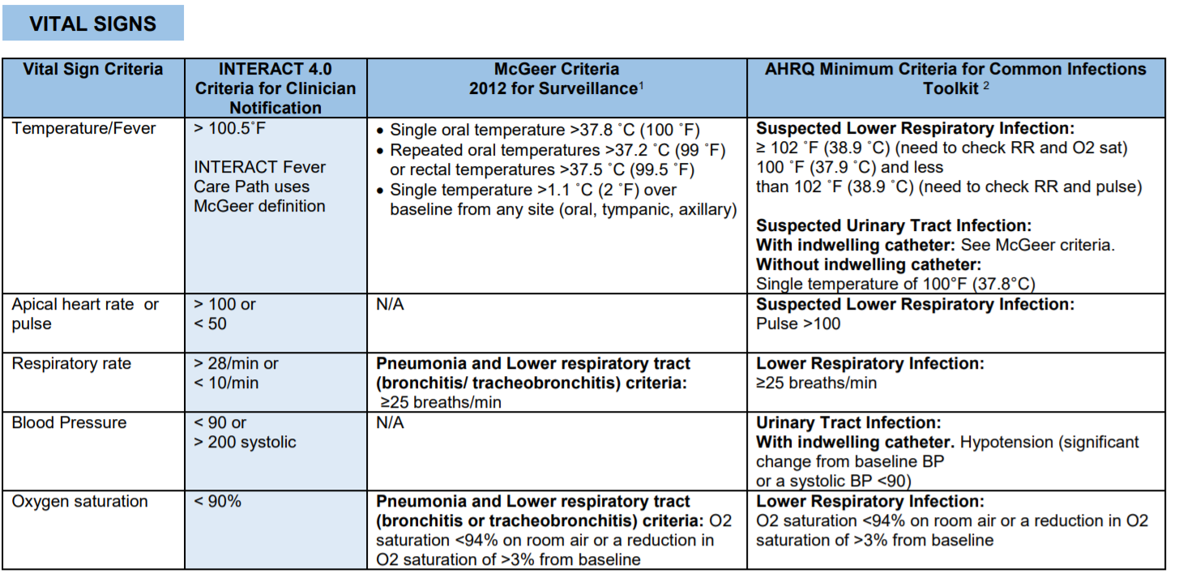
Vital Signs
Notes:
INTERACT. (2017) INTERACT Guidance on Identification and Management of Infections. Retrieved from https://pathway-interact.com/wp-content/uploads/2017/11/INTERACT-guidance-on-infections-updated-November-7-2017.pdf

Slide 82
Lower Respiratory Infection
Notes:
INTERACT. (2017) INTERACT Guidance on Identification and Management of Infections. Retrieved from https://pathway-interact.com/wp-content/uploads/2017/11/INTERACT-guidance-on-infections-updated-November-7-2017.pdf

Slide 83
Lower Respiratory Infection Continued
Notes:
INTERACT. (2017) INTERACT Guidance on Identification and Management of Infections. Retrieved from https://pathway-interact.com/wp-content/uploads/2017/11/INTERACT-guidance-on-infections-updated-November-7-2017.pdf

Slide 84
UTI
Notes:
INTERACT. (2017) INTERACT Guidance on Identification and Management of Infections. Retrieved from https://pathway-interact.com/wp-content/uploads/2017/11/INTERACT-guidance-on-infections-updated-November-7-2017.pdf

Slide 85
UTI Continued
Notes:
INTERACT. (2017) INTERACT Guidance on Identification and Management of Infections. Retrieved from https://pathway-interact.com/wp-content/uploads/2017/11/INTERACT-guidance-on-infections-updated-November-7-2017.pdf

Slide 86
GI
Notes:
INTERACT. (2017) INTERACT Guidance on Identification and Management of Infections. Retrieved from https://pathway-interact.com/wp-content/uploads/2017/11/INTERACT-guidance-on-infections-updated-November-7-2017.pdf

Slide 87
INTERACT Guidance on Identification & Management of Infections
For Vital signs INTERACT compares their tool with standards on infection identification designed by McGreer Surveillance Criteria published in 2012 and with the AHRQ Minimum Criteria for Infections Toolkit
For Lower Respiratory Tract Infections and For Urinary Tract Infections, Loeb criteria are added for comparison
For Gastrointestinal Infections Interact and McGreer are compared
Notes:
INTERACT. (2017). INTERACT Guidance on Identification and Management of Infections. Retrieved from https://pathway-interact.com/wp-content/uploads/2017/11/INTERACT-guidance-on-infections-updated-November-7-2017.pdf

Slide 88
INTERACT Guidance on Identification & Management of Infections
For each common site of infection that has the potential to lead to sepsis INTERACT provides some recognition tools that are simple and easy to implement
For higher level providers such as Nurse Practitioners and Physicians the McGreer and AHRQ criteria are useful.
For bedside nurses, the simpler INTERACT criteria may be easier to implement and easier to train nurses and certified nursing assistants to implement.
They key is to pick criteria that will not be overly burdensome for the level of personnel who are expected to implement them.
These tools will be made available to you so that you can customize them for your institution and your needs.
Notes:
INTERACT. (2017). INTERACT Guidance on Identification and Management of Infections. Retrieved from https://pathway-interact.com/wp-content/uploads/2017/11/INTERACT-guidance-on-infections-updated-November-7-2017.pdf

Slide 89
Patient Safety Movement: Roles for All
Family
Certified Nursing Assistant
Nursing supervisor
Medical Director
On Call Physicians
Sepsis Coordinators
Laboratory
Notes:
Patient Safety Movement. (2016). Actionable Patient Safety Solution (APSS) #9A: EARLY DETECTION & TREATMENT OF SEPSIS FOR HIGH-INCOME COUNTRIES. Retrieved from https://patientsafetymovement.org/wp-content/uploads/2016/02/APSS-9A_-Early-Detection-Treatment-of-Sepsis.pdf

Slide 90
Patient Safety Movement: Executive Summary
Develop a team approach to implement a protocol for early sepsis identification and treatment including representation from Administration, Nursing, Medical Director and Pharmacy.
Create a sepsis dashboard for your organization’s leadership.
Implement a Sepsis Rapid Response Team or incorporate early detection of sepsis into your existing teams (e.g. rapid response teams).
Formalize processes to screen patients for signs of sepsis throughout the entire institution.
Implement an effective monitoring and screening system to accomplish continuous monitoring and early detection, based on existing data (SIRS criteria, or any other warning system being used).
Notes:
Patient Safety Movement. (2016). Actionable Patient Safety Solution (APSS) #9A: EARLY DETECTION & TREATMENT OF SEPSIS FOR HIGH-INCOME COUNTRIES. Retrieved from https://patientsafetymovement.org/wp-content/uploads/2016/02/APSS-9A_-Early-Detection-Treatment-of-Sepsis.pdf

Slide 91
Patient Safety Movement: Surveillance
Implement an effective monitoring system to accomplish continuous monitoring and notification based upon acute changes in the following data:
Fever (> 38.3°C)
Hypothermia (temperature < 36°C)
Heart rate > 90/min or 1 or more than two standard deviations above the normal value for age
Tachypnea (RR > 20)
Altered mental status
Hyperglycemia (plasma glucose > 140 mg/dL or 7.7 mmol/L) in the absence of diabetes
Leukocytosis (WBC count > 12,000 μL–1)
Leukopenia (WBC count < 4000 μL–1)
Normal WBC count with greater than 10% immature forms
Hypotension (SBP < 90 mm Hg, MAP < 70 mmHg, or an SBP decrease > 40 mmHg in adults or less than two standard deviations below normal for age)
Notes:
Patient Safety Movement. (2016). Actionable Patient Safety Solution (APSS) #9A: EARLY DETECTION & TREATMENT OF SEPSIS FOR HIGH-INCOME COUNTRIES. Retrieved from https://patientsafetymovement.org/wp-content/uploads/2016/02/APSS-9A_-Early-Detection-Treatment-of-Sepsis.pdf

Slide 92
Patient Safety Movement: Executive Summary
Leverage your EHR to serve as a data collection tool and repository for predicting risk of sepsis for patients. A system that provides a data collection tool and allows for continuous analysis and surveillance will be most beneficial.
Implementation of automated electronic screening and documentation of process of care based on existing data (SIRS criteria, or any other warning system being used).
Design a workflow specific to level of alert
Screening: SIRS/Sepsis/Septic shock workflow
Mortality Prediction: qSOFA (or “Level of Risk”)
Notes:
Patient Safety Movement. (2016). Actionable Patient Safety Solution (APSS) #9A: EARLY DETECTION & TREATMENT OF SEPSIS FOR HIGH-INCOME COUNTRIES. Retrieved from https://patientsafetymovement.org/wp-content/uploads/2016/02/APSS-9A_-Early-Detection-Treatment-of-Sepsis.pdf

Slide 93
Patient Safety Movement: Executive Summary
Implement a process for continuous monitoring of electronic systems and protocols
Compliance, efficacy and outcome measures
Implement case reviews for outliers
Treatment/Interventions
Implement protocol for rapid assessment and intervention at the bedside and initiate sepsis bundles
Notes:
Patient Safety Movement. (2016). Actionable Patient Safety Solution (APSS) #9A: EARLY DETECTION & TREATMENT OF SEPSIS FOR HIGH-INCOME COUNTRIES. Retrieved from https://patientsafetymovement.org/wp-content/uploads/2016/02/APSS-9A_-Early-Detection-Treatment-of-Sepsis.pdf

Slide 94
Patient Safety Movement: Patient & Family Engagement
Create materials or resources (website, classes, pamphlets, videos, etc) for residents and families regarding :
A. Sepsis: what it is, risks, prevention, early detection, management, possible trajectory (ICU, post-ICU), outcomes
i. How you, as the patient or family member, can participate in prevention and early detection
B. The SNF’s sepsis program –what, when, who, etc.? e.g., screening, code sepsis, etc.
C. Who and how to contact if the family suspects sepsis
Notes:
Patient Safety Movement. (2016). Actionable Patient Safety Solution (APSS) #9A: EARLY DETECTION & TREATMENT OF SEPSIS FOR HIGH-INCOME COUNTRIES. Retrieved from https://patientsafetymovement.org/wp-content/uploads/2016/02/APSS-9A_-Early-Detection-Treatment-of-Sepsis.pdf

Slide 95
Patient Safety Movement: Communication
Implement standardized protocols for patient/family engagement/communication
Coordinate with family or caregiver to reduce sepsis risk factors and identify clinical indicators at first sign
Disclose all sepsis related events
Provide an explanation as to why/how the sepsis occurred;
Explain how the effects of sepsis will be minimized; and
Discuss/state steps that the caregiver or organization will take to prevent recurrences of sepsis
Notes:
Patient Safety Movement. (2016). Actionable Patient Safety Solution (APSS) #9A: EARLY DETECTION & TREATMENT OF SEPSIS FOR HIGH-INCOME COUNTRIES. Retrieved from https://patientsafetymovement.org/wp-content/uploads/2016/02/APSS-9A_-Early-Detection-Treatment-of-Sepsis.pdf

Slide 96
Notes:
Sepsis Alliance. (2014). Faces of Sepsis. Retrieved from https://www.youtube.com/watch?v=12Qbnn6XfH0

Slide 97
Sepsis Training Day 2
MARCH 24 , 2021
Questions

Slide 98
Pretest Question Review
Question One:
What factors are associated with higher mortality for sepsis?
Old Age
Cancer
Previous sepsis
All of the above
Answer One: D (All of the above)

Slide 99
Pretest Question Review
Question Two:
Which of the following laboratory studies normally done to confirm or rule out sepsis can be used as a criterion to decide whether to transfer to an acute care facility.?
Lactate
Creatinine
WBC
Hemoglobin
INR
Answer Two: A (Lactate)

Slide 100
Pretest Question Review
Question Three:
If you have resident suspicious for sepsis who is being treated in the facility with fluids and antibiotics whose MAP drops below 65 what steps should you take.
Document the vitals.
Prepare a SBAR.
Contact the nursing supervisor.
Notify the physician on call.
All of the above
Question Three: E (all of the above)

Slide 101
Pretest Question Review
Question Four:
A family member is visiting and reports that their loved one seems less lucid than at the last visit and won’t eat. What steps should you take?
Document the report of a change in mental status.
Assess mental status and report the score the nursing supervisor.
Wait until the shift changes and put it in your note.
A and B.
Question Four: D (both A & B)

